Slide 1
Presentation Topics
Essential Ideas

Slide 2
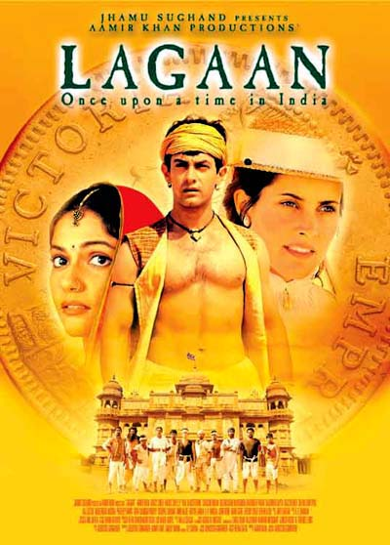
Bollywood
India’s film industry.
Makes about 800 films/year.
Films are like musicals, they feature colorful costumes, songs, and dances.
Often 2 to 3 hours long – longer than a typical Hollywood movie.
Millions of people in India of all backgrounds and people around the world watch Bollywood films.

Slide 3
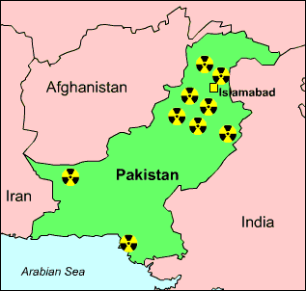
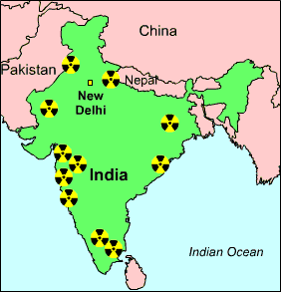
Nuclear Weapons
India first to develop a nuclear weapon.
Both India & Pakistan have nuclear weapons.
They have nuclear weapons for fear of the other.
Both invest a lot of money in these programs.
Neither has signed the Nuclear Non-Proliferation Treaty.
IF either country were to use their nuclear weapons, it would likely be over the conflict in Kashmir.

Slide 4
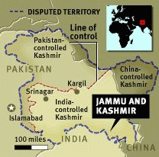
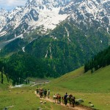
Conflict in Kashmir
Territory gained by India after the Partition in 1947.
The Maharaja (Prince) of Kashmir decided to join India, despite the population being mostly Muslim.
India and Pakistan have fought 3 wars over Kashmir.
Pakistan is thought to be giving weapons to militants living in Kashmir.

Slide 5
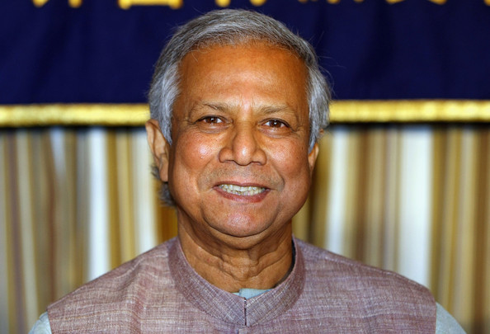
Microcredit/Microfinance
Small loans given to poor people in developing countries.
Loans are to help people start businesses.
Grameen Bank is a famous microcredit bank.
It was started in Bangladesh by Muhammad Yunus.
Muhammad Yunus

Slide 6
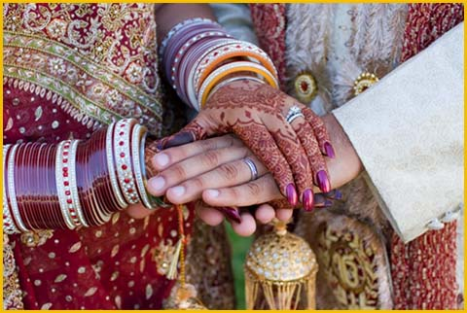
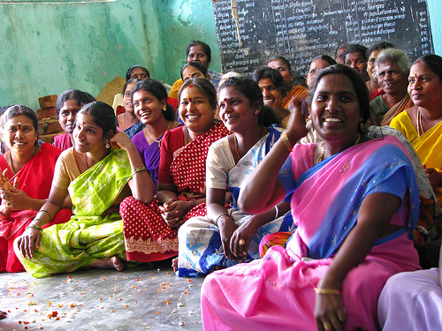
Women & Gender Imbalance
In South Asia, males outnumber females in many regions.
Purdah – the practice of concealing women from the eyes of nonfamily men. It is also a sign of wealth, because it means the woman does not have to leave the home to work.
Dowry – price paid by the family of the bride to the groom.
Bride Price – opposite of dowry. Money the groom pays to the bride’s family.
Sati – practice of a widow committing suicide by sitting atop her husband’s funeral pyre.

Slide 7
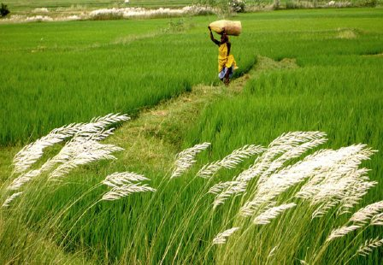
Green Revolution
Green Revolution’s Goal:
Program started in the late 1960s that aimed to increase crop harvests and alleviate hunger in many regions of the world, including India.
How?
Fertilizers
Pesticides & herbicides
Genetically modified seeds
Mechanized equipment & irrigation
What is agro-ecology?
Alternative to Green Revolution.
Promotes using natural methods to increase harvests.

Slide 8
Outsourcing to India
What is it?
When a company contracts to have some of its business functions performed in a country other than the one where its products and services are actually developed, manufactured, and sold.
What types of jobs?
Information technology, call centers, pharmaceutical research.
Why to India?
Educated, English-speaking population.
Companies save money because salaries are lower in India compared to the United States.

